Slide 1
Draft Resolution 3.3.2/1 (RA VI-19(I)) Implementation of Global and Regional Basic Observing Networks (GBON/RBON) and the Systematic Observations Financing Facility (SOFF)

Slide 2
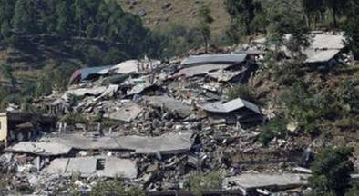
Regional Basic Observing Network (RBON)
network of surface‑based meteorological, hydrological and related observing stations/platforms to address the key regional weather, water, climate and other environmental challenges.
leads to improved services by delivering more and enhanced observations to stakeholders.
enables the full benefit of regional and national observing capabilities to be realized.
is defined and adopted by the relevant WMO Regional Association, or the Executive Council or the World Meteorological Congress for the Antarctic.
Work plan for consideration of EW4All observational user requirements and gaps through RBON (Resolution 2 (EC-78))
EW4All Action Plan for RA-VI: No. 2.1 (Draft Resolution 3.2/1 (RA VI-19(I))

Slide 3
Background / Justification
Noting:
The progress made by Members in increasing the number of Global Basic Observing Network (GBON) stations in the Region as listed in the Observing Systems Capability Analysis and Review tool/Surface (OSCAR/Surface) and visible in the WMO Integrated Global Observing System (WIGOS) Data Quality Monitoring System (WDQMS) and reported by the president.
The work conducted by the RA VI Working Group on Infrastructure in implementing the RBON design process.
Acknowledging:
That the Systematic Observations Financing Facility (SOFF) is a foundational element of the United Nations Early Warnings for All for All initiative and an integral part of the United Nations Secretary-General’s EW4All Action Plan.
With appreciation that Members from RA VI have contributed USD 81 million to SOFF as of August 2024 and actively contributed to the SOFF activities as Peer Advisors.

Slide 4
Action(s) required
Requests the Management Group:
To keep under review the progress of the Region in the implementation of the GBON and WMO Unified Data Policy at their meetings;
To establish a working mechanism (Focus Group) within the Working Group for Observation, Infrastructure and Information Systems in order to foster the RBON design and implementation in the Region by undertaking the activities present in the annex;
To facilitate collaboration between the Working Group for Observation, Infrastructure and Information Systems and the Standing Committee on Earth Observing Systems and Monitoring Networks (SC-ON) of the Infrastructure Commission on the RBON design and implementation, as needed;
To engage with regional/subregional partner organizations and programmes in relevant RBON implementation activities.

Slide 5
Action(s) required
Urges Members:
To participate in the RBON design and implementation in the Region by:
Providing the working mechanism to be established with experts, together with technical expertise and necessary information for the assessment of the existing observational capabilities;
Inviting national partner organizations and programmes to participate in relevant RBON implementation activities.

